Slide 1
Single-Cell RNA Data Analysis with Galaxy
Based on: https://training.galaxyproject.org/training-material/topics/transcriptomics/
Xie Zihong
2021.4.23

Slide 2
CONTENTS
1
Introduction
2
Process
Data Preparation
Quality Control
Normalisation and Scaling
Dimensionality Reduction
Clustering
Annotation
Etc.

Slide 3
01
Introduction

Slide 4
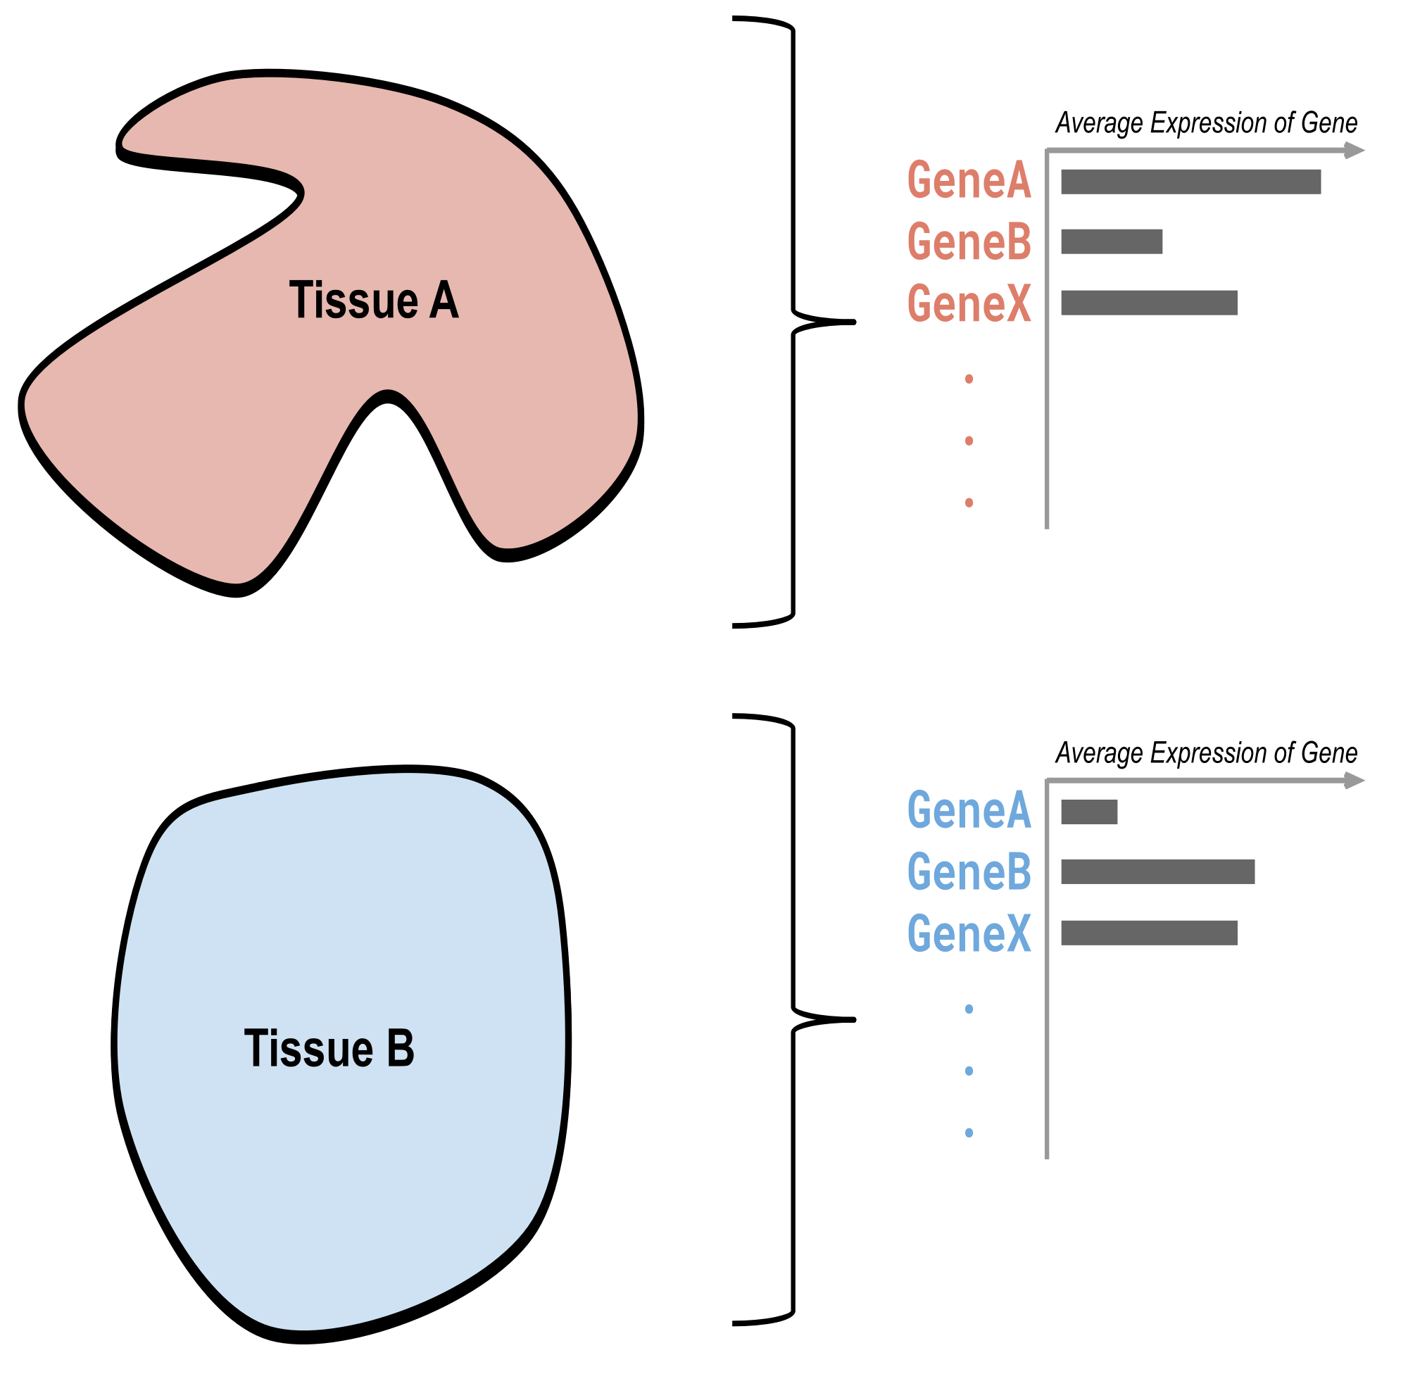
What is single-cell RNA data analysis?
Compare two tissues
Average gene expression per tissue
(with high sequencing depth and analysis strength)
Differential expression is measured
Bulk RNA-seq Analysis
https://training.galaxyproject.org/training-material/topics/transcriptomics/tutorials/scrna-intro/slides.html#p6

Slide 5
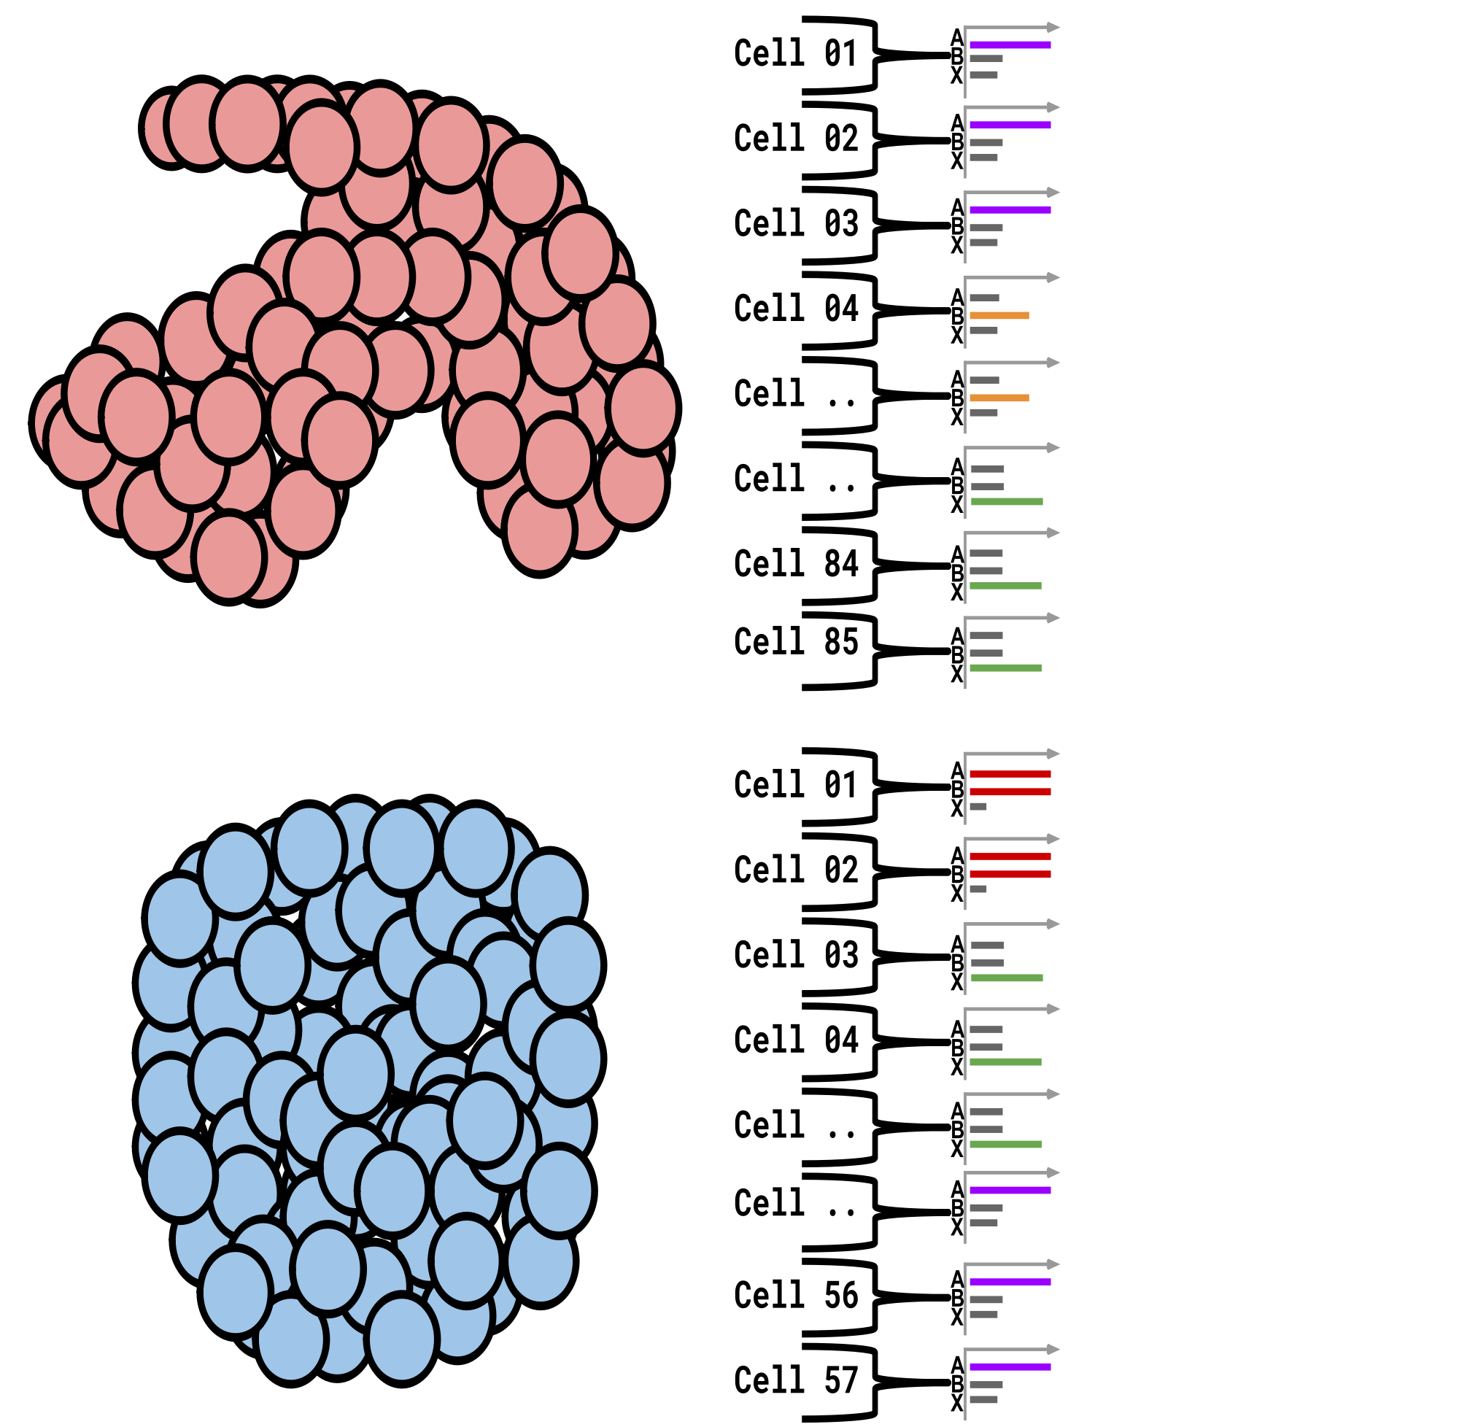
What is single-cell RNA data analysis?
Individual cells within tissues
Indivisual gene expression per cell
Many cells share the same gene profile
Compare one set of cells against another
Single-cell RNA-seq Analysis
https://training.galaxyproject.org/training-material/topics/transcriptomics/tutorials/scrna-intro/slides.html#p7

Slide 6
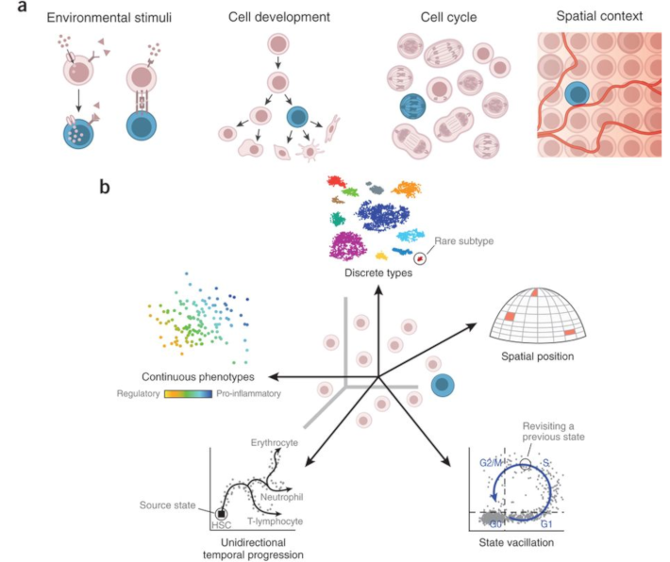
Figure : Revealing the vectors of cellular identity with single-cell genomics, Nature Biotechnology, 2016

Slide 7
02
Process

Slide 8
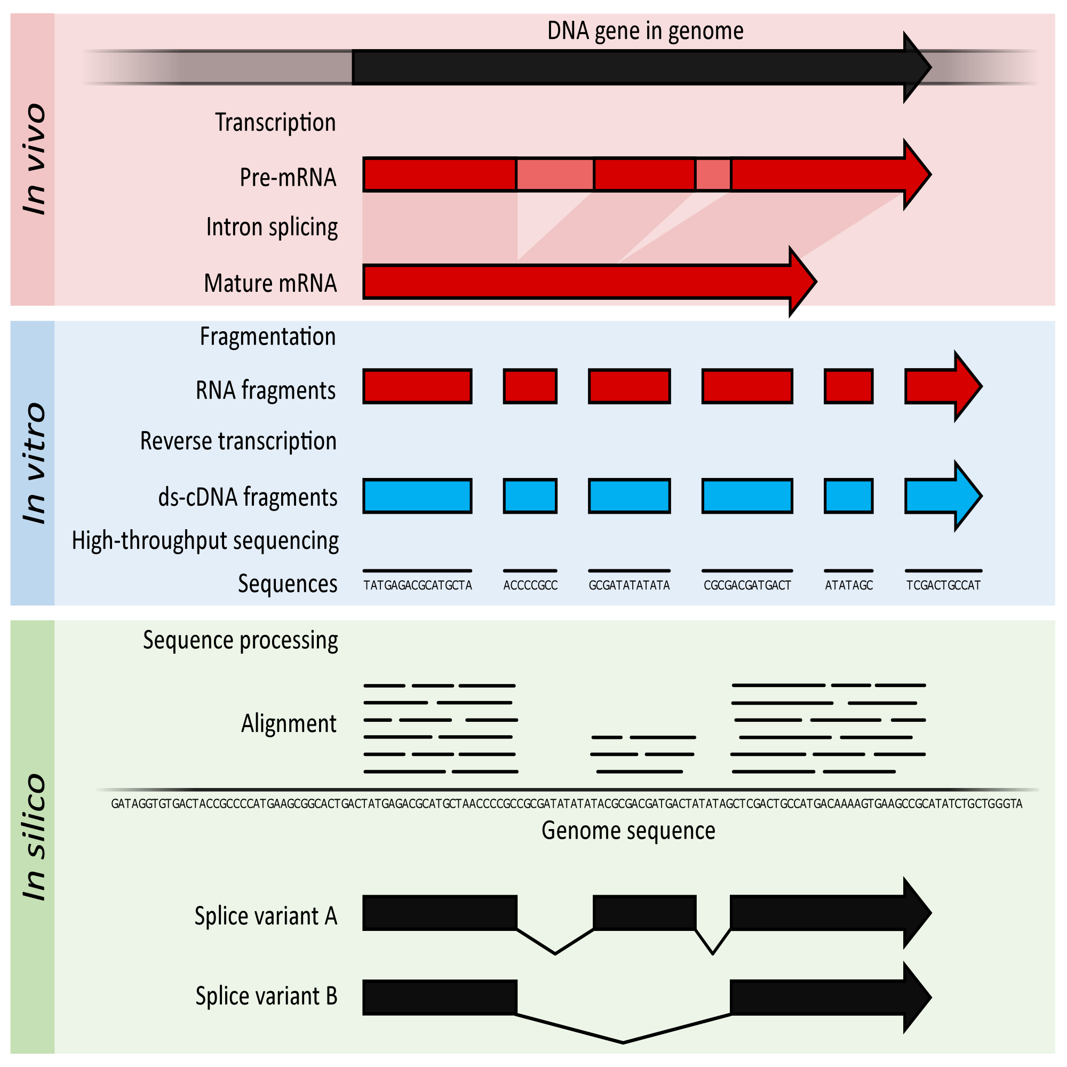
Bulk RNA Analysis
For each fragment in the library, a short sequence is generated, also called a read, which is simply a succession of nucleotides.
Read mapping is the process to align the reads on a reference genomes.
https://upload.wikimedia.org/wikipedia/commons/f/f3/Summary_of_RNA-Seq.svg

Slide 9
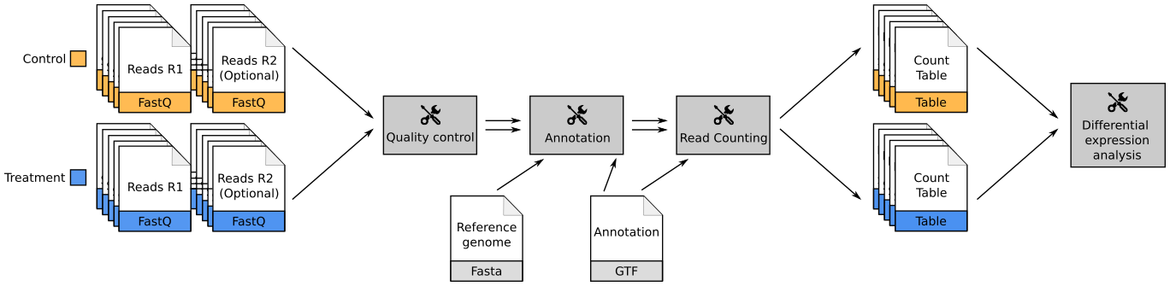
Bulk RNA Analysis
A BAM (Binary Alignment Map) file is a compressed binary file storing the read sequences, whether they have been aligned to a reference sequence.
BAM
FASTQ format is a text-based format for storing both a biological sequence (usually nucleotide sequence) and its corresponding quality scores.
The Gene transfer format (GTF) is a file format used to hold information about gene structure.
The number of reads mapped to each gene can be counted. This results in a table of counts, which is what we perform statistical analyses on to determine differentially expressed genes and pathways.
https://training.galaxyproject.org/training-material/topics/transcriptomics/images/rna_seq_workflow.png

Slide 10
Bulk RNA Analysis
FASTQ:
@SRR031716.1 HWI-EAS299_4_30M2BAAXX:3:1:944:1798 length=37
GTGGATATGGATATCCAAATTATATTTGCATAATTTG
+SRR031716.1 HWI-EAS299_4_30M2BAAXX:3:1:944:1798 length=37
IIIIIIIIIIIIIIIIIIIIIIIIIIIII8IIIIIII
Line | Description
1 | Always begins with @ followed by the information about the read
2 | The actual nucleic sequence
3 | Always begins with a + and contains sometimes the same info in line 1
4 | Has a string of characters which represent the quality scores associated with each base of the nucleic sequence

Slide 11
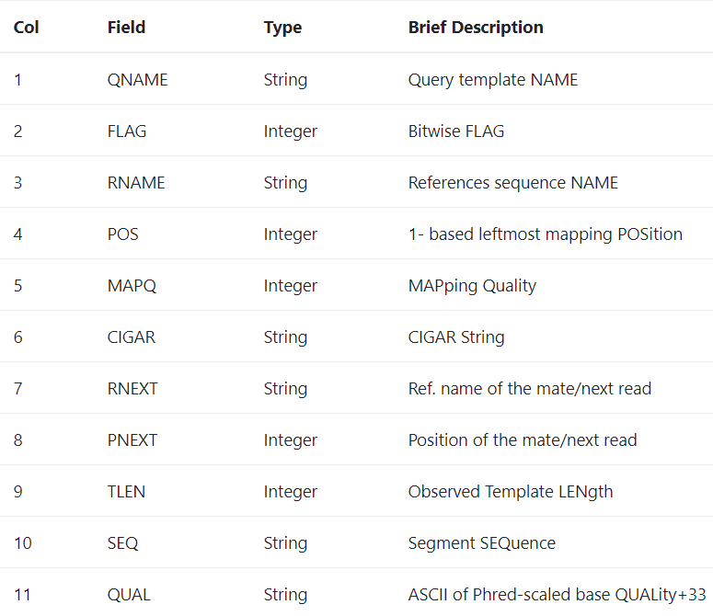
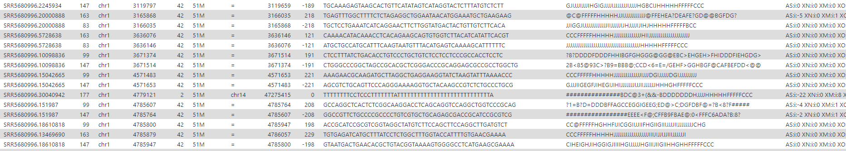
Bulk RNA Analysis
BAM:

Slide 12

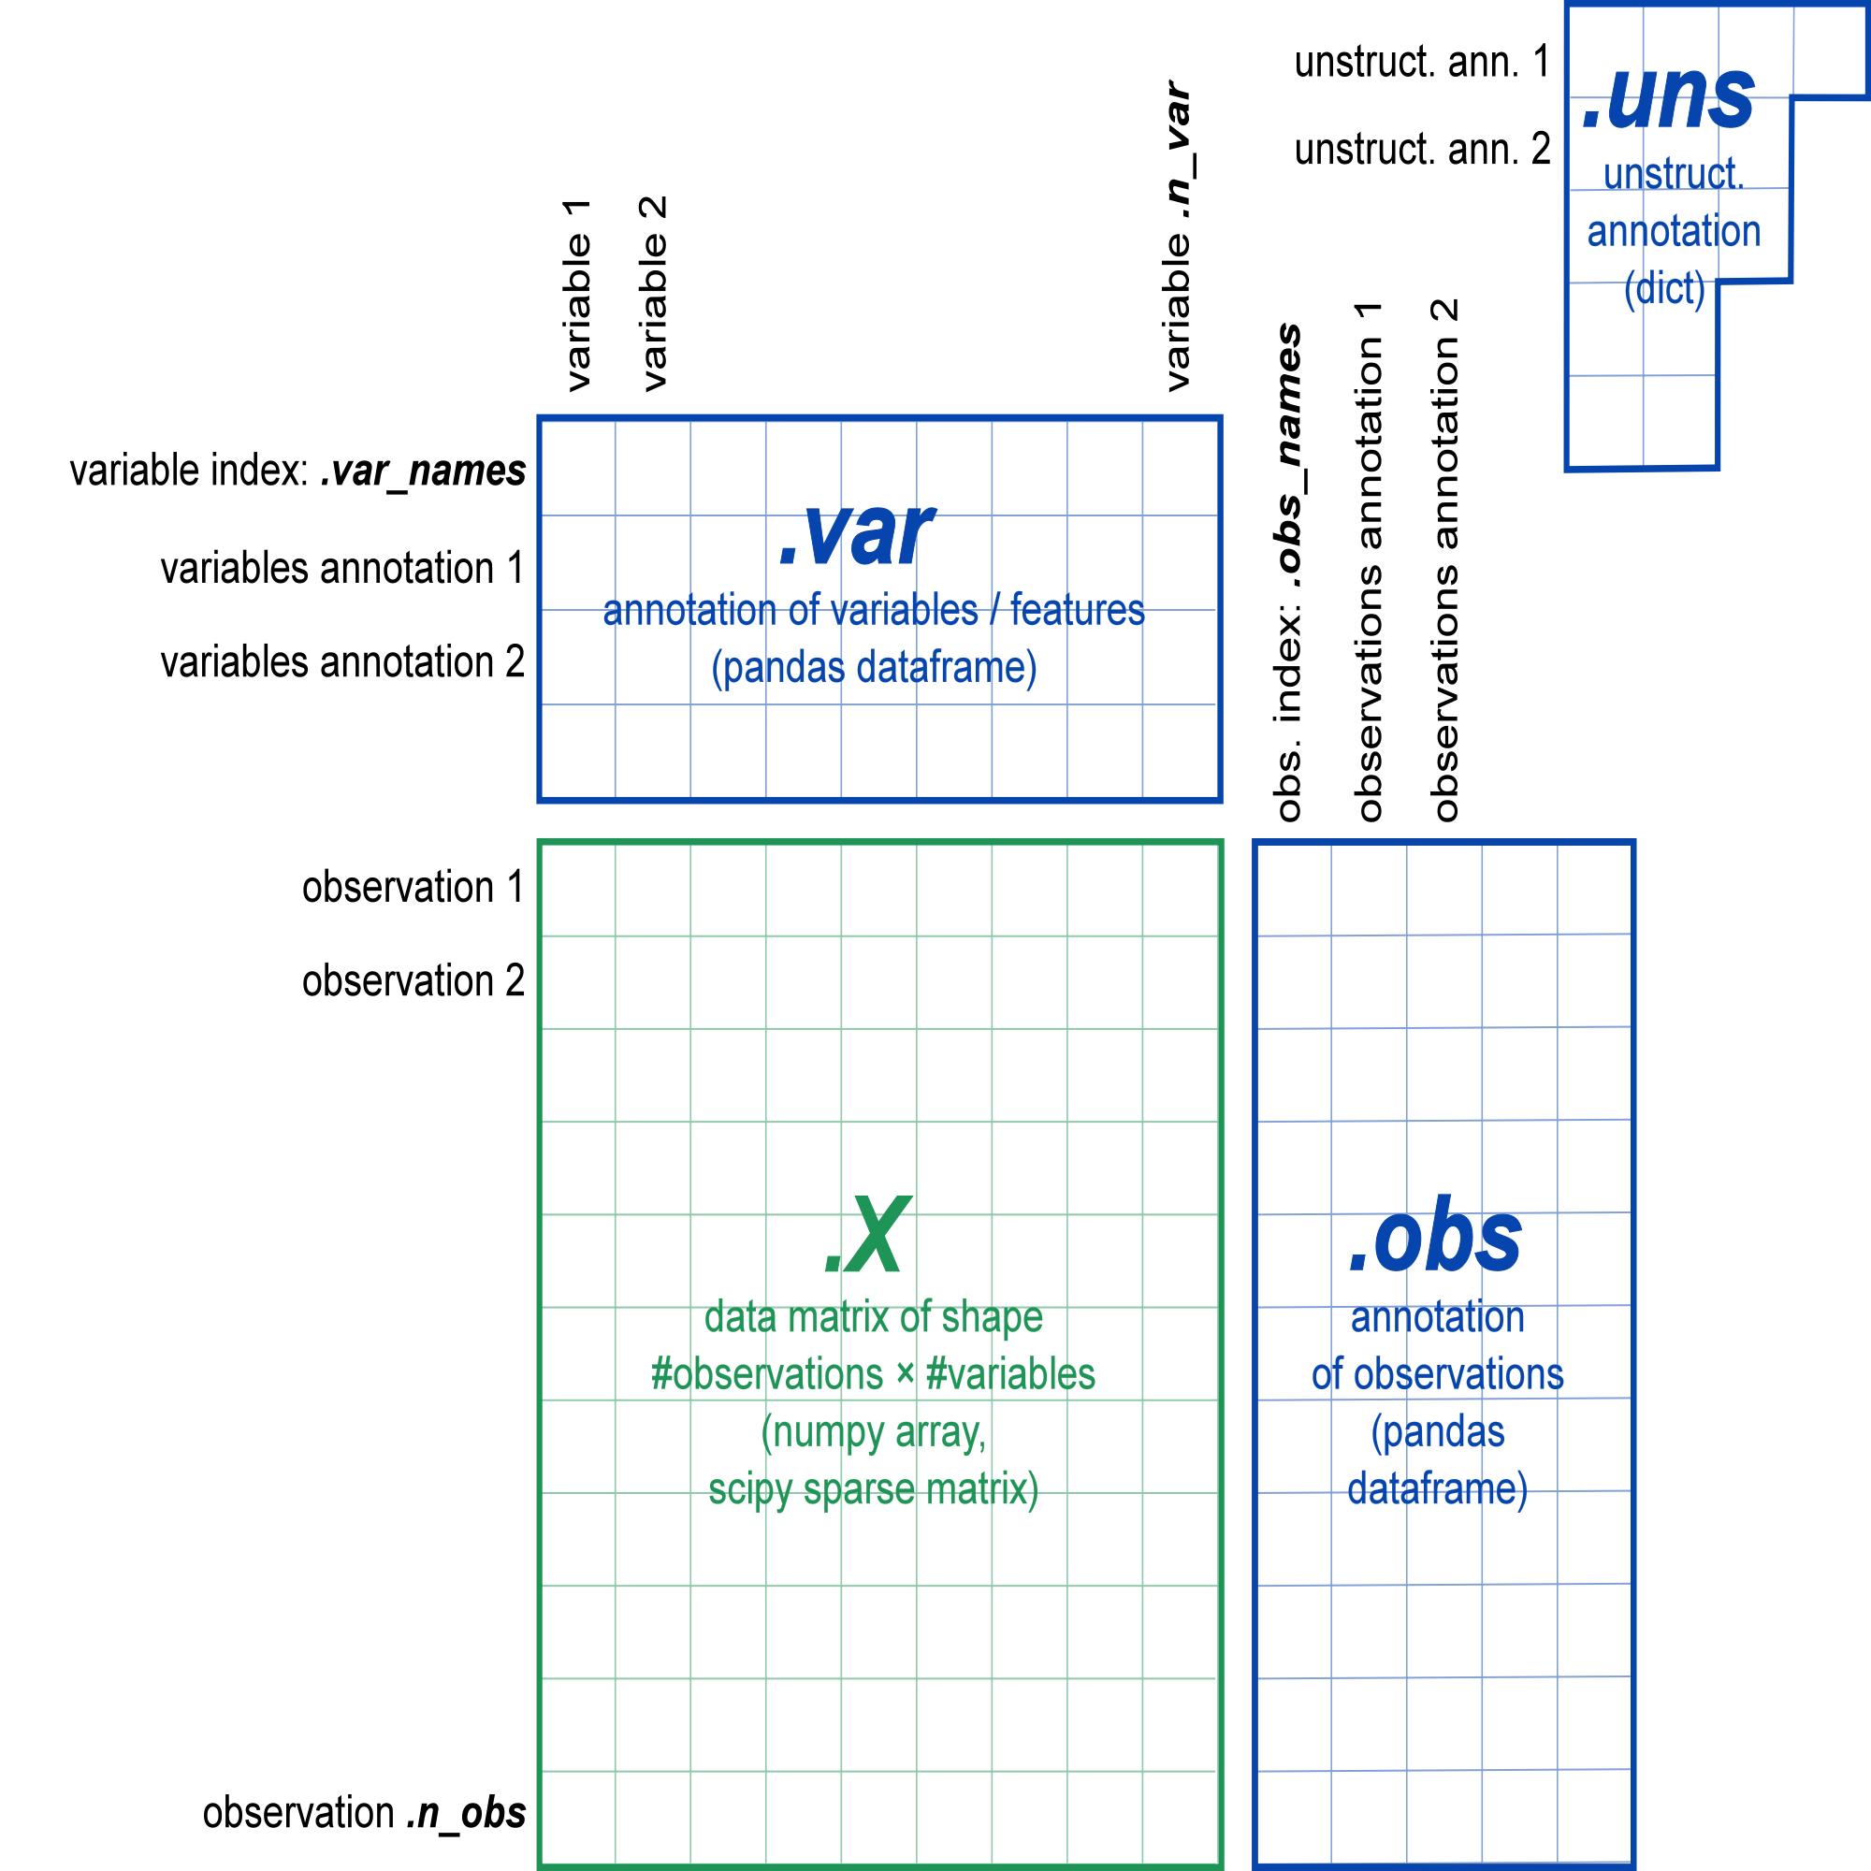
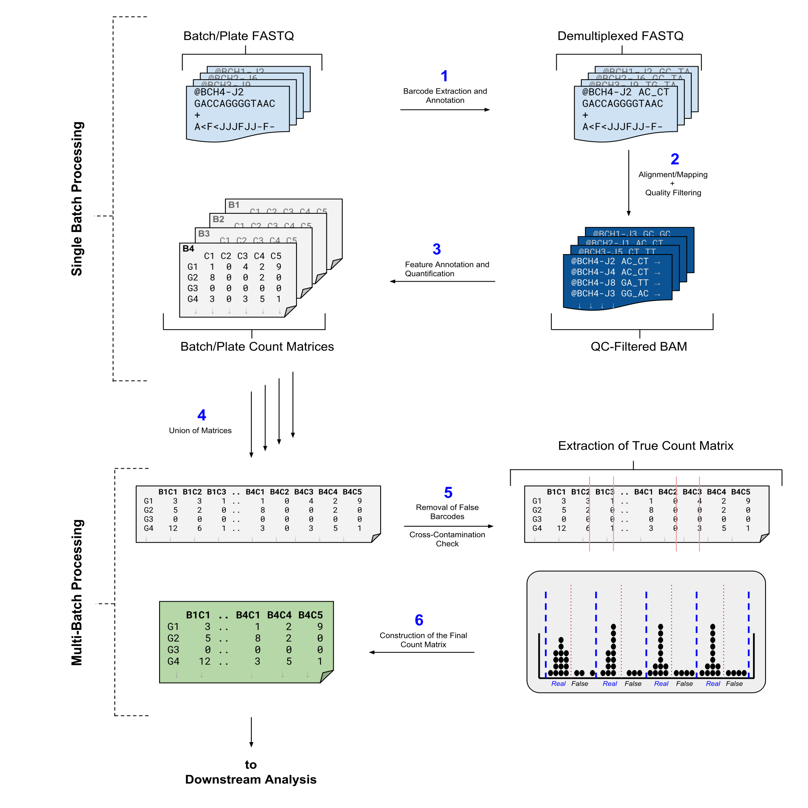
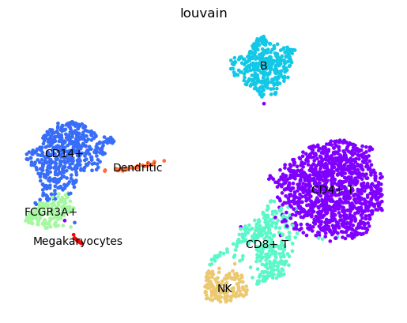
scRNA Analysis
.FASTQ
.gtf
.FASTQ
.fastq
.fastq
Sequencing
Data Preparation
Quality Control
Normalisation and Scaling
Dimensionality Reduction
Clustering
Annotation,
Lineage Analysis, etc.

Slide 13
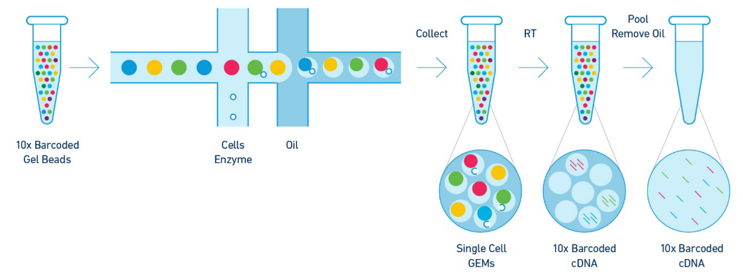
Sequencing
scRNA Sequencing
Methods
Cut a thin slice of a tissue
Breakdown a tissue into cells
Isolate each cell
Add enzyme to break down cell walls
Perform barcoding
Perform sequencing in a common pool
CEL-seq
SCRB-seq
Drop-seq
10x Genomics
……
cost-effective
high-throughput
https://training.galaxyproject.org/training-material/topics/transcriptomics/images/tenx_libprep.png

Slide 14
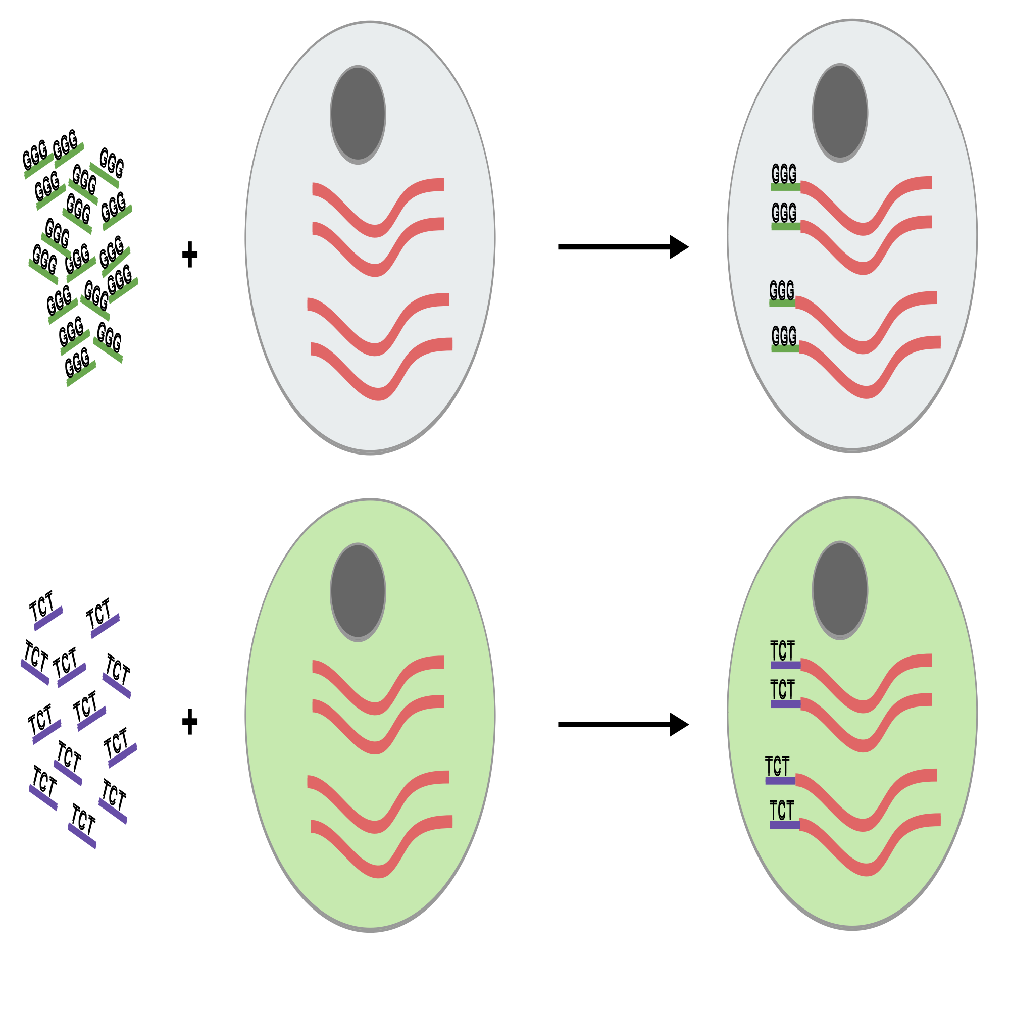
Sequencing
How to distinguish different cells in a sample?
Barcode
Unique sequences
To delineate one cell from another
Read transcripts containing different cell barcodes can be derived from different cells
https://training.galaxyproject.org/training-material/topics/transcriptomics/images/scrna_pbb_barcodes_add.svg

Slide 15
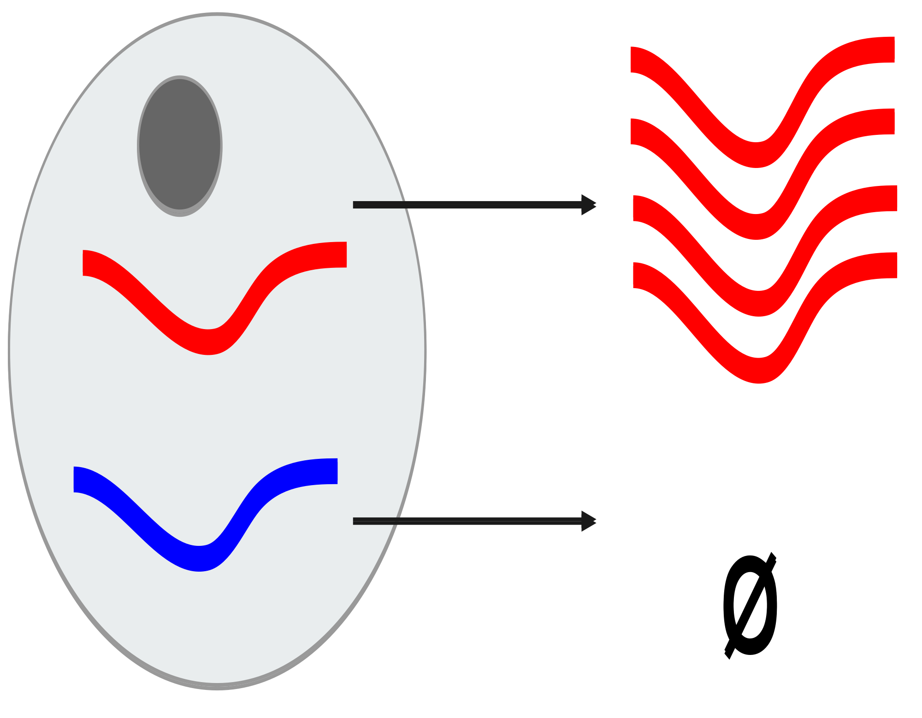
Sequencing
Exponential Bias
The amount to amplify is very small, and many unique reads might be missed during this phase whereas others may be over amplified.
https://training.galaxyproject.org/training-material/topics/transcriptomics/tutorials/scrna-intro/slides.html#p24

Slide 16
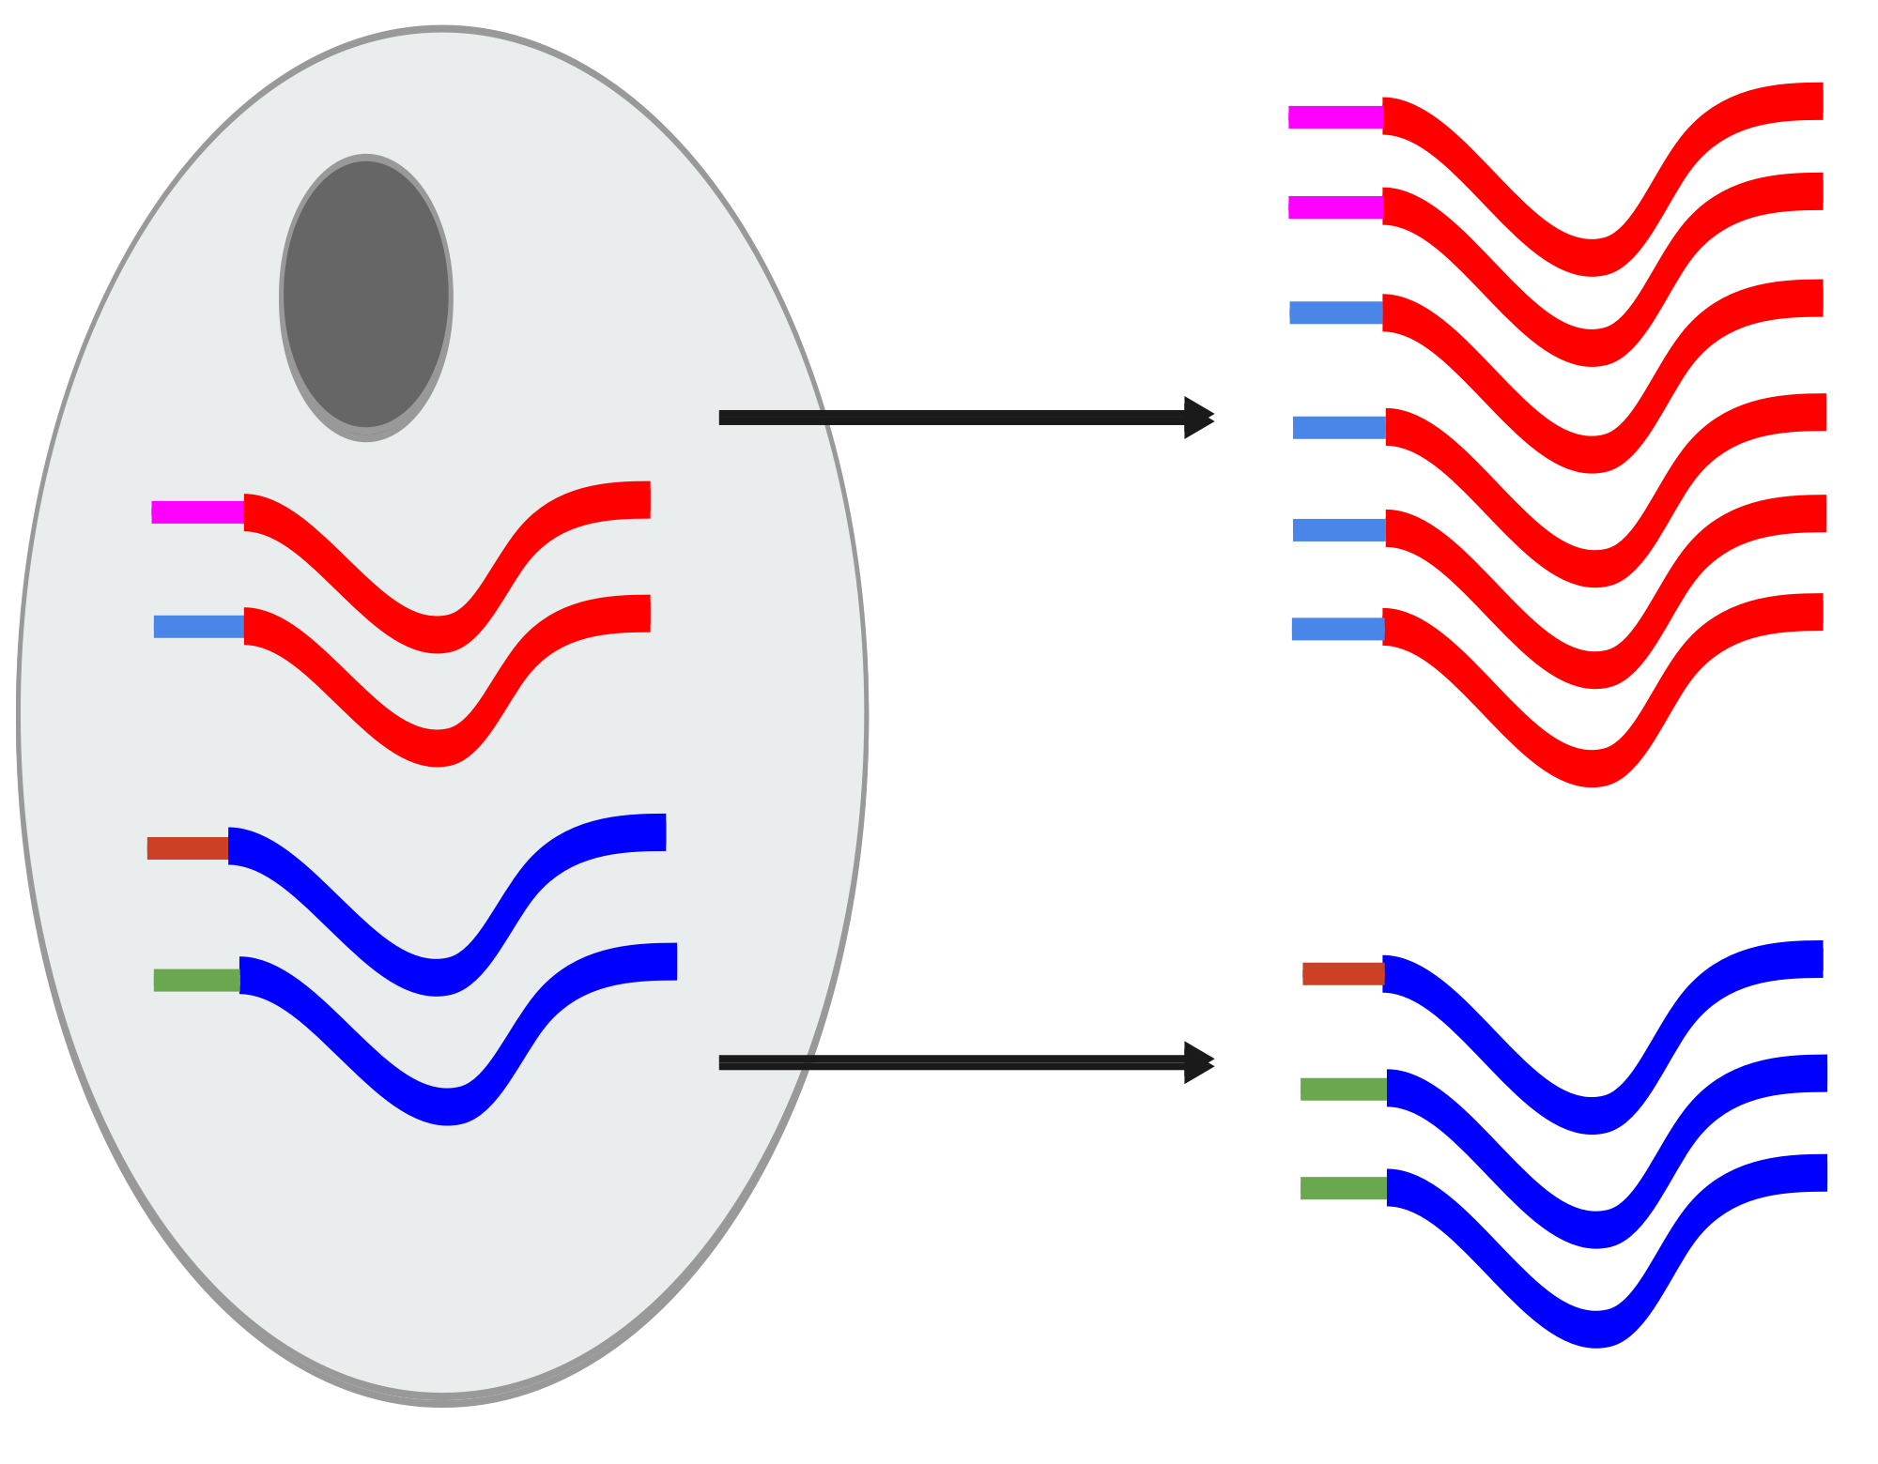
Sequencing
 | Original Counts
Red | 6
Blue | 3
 | Set of UMIs | UMIs
Red | {Pink, Blue} | 2
Blue | {Brown, Green} | 2
Unique Molecular Identifiers (or UMIs)
 | True Counts
Red | 2
Blue | 2
These random barcodes known as UMIs, uniquely tag transcripts such that any two transcripts of the same gene are likely to have different random barcodes.
https://training.galaxyproject.org/training-material/topics/transcriptomics/images/scrna_amplif_errors_umis.svg

Slide 17
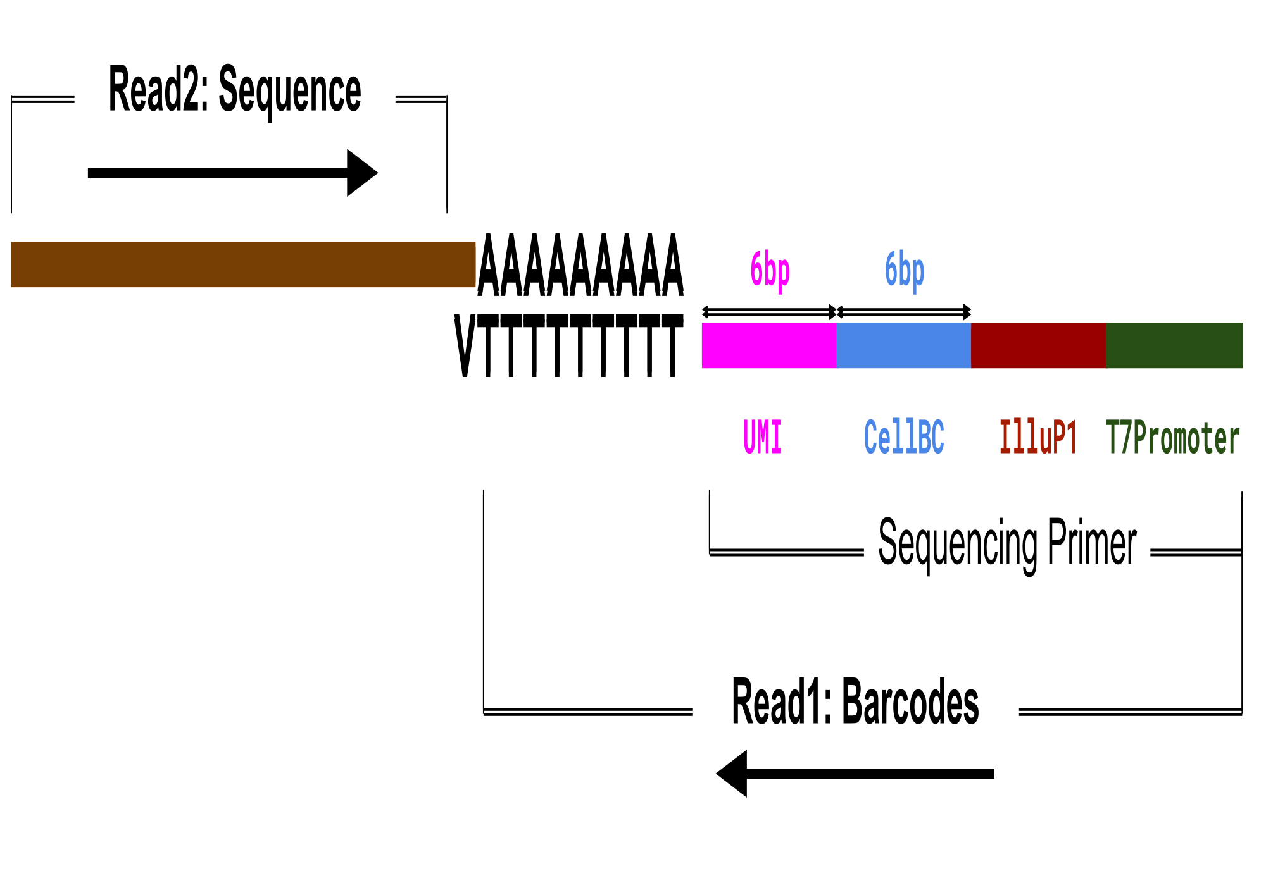
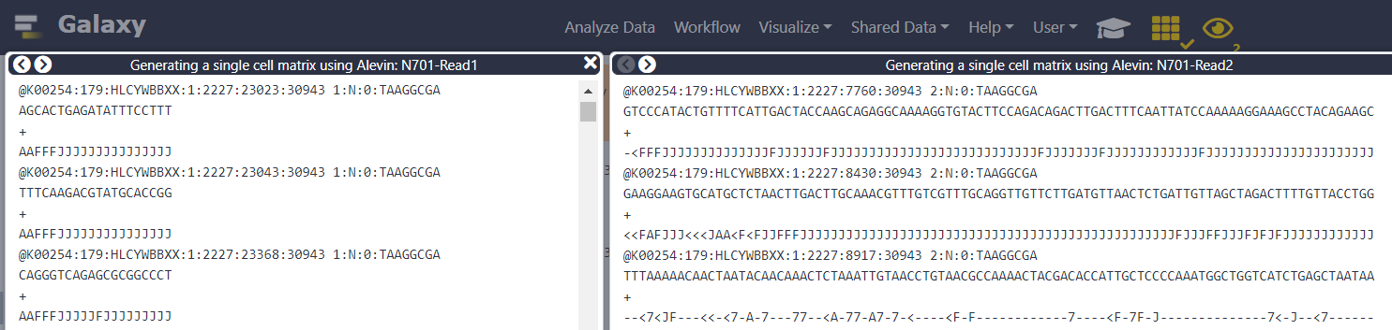
Sequencing
Read1.fastq and Read2.fastq:
https://training.galaxyproject.org/training-material/topics/transcriptomics/images/celseq2_schema.svg

Slide 18
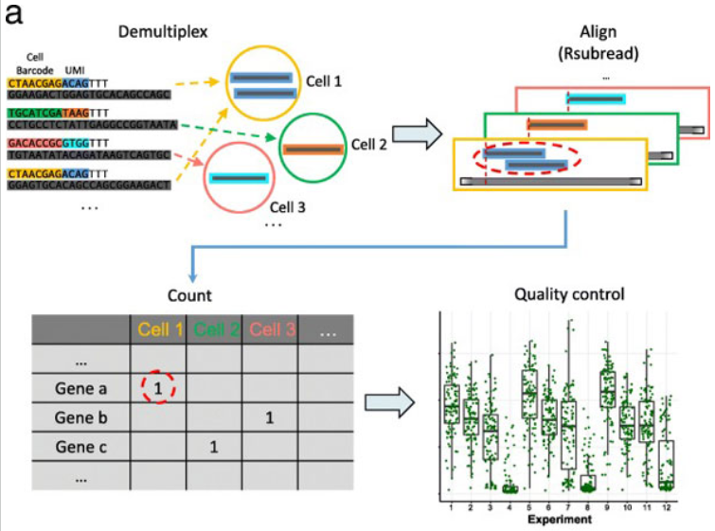
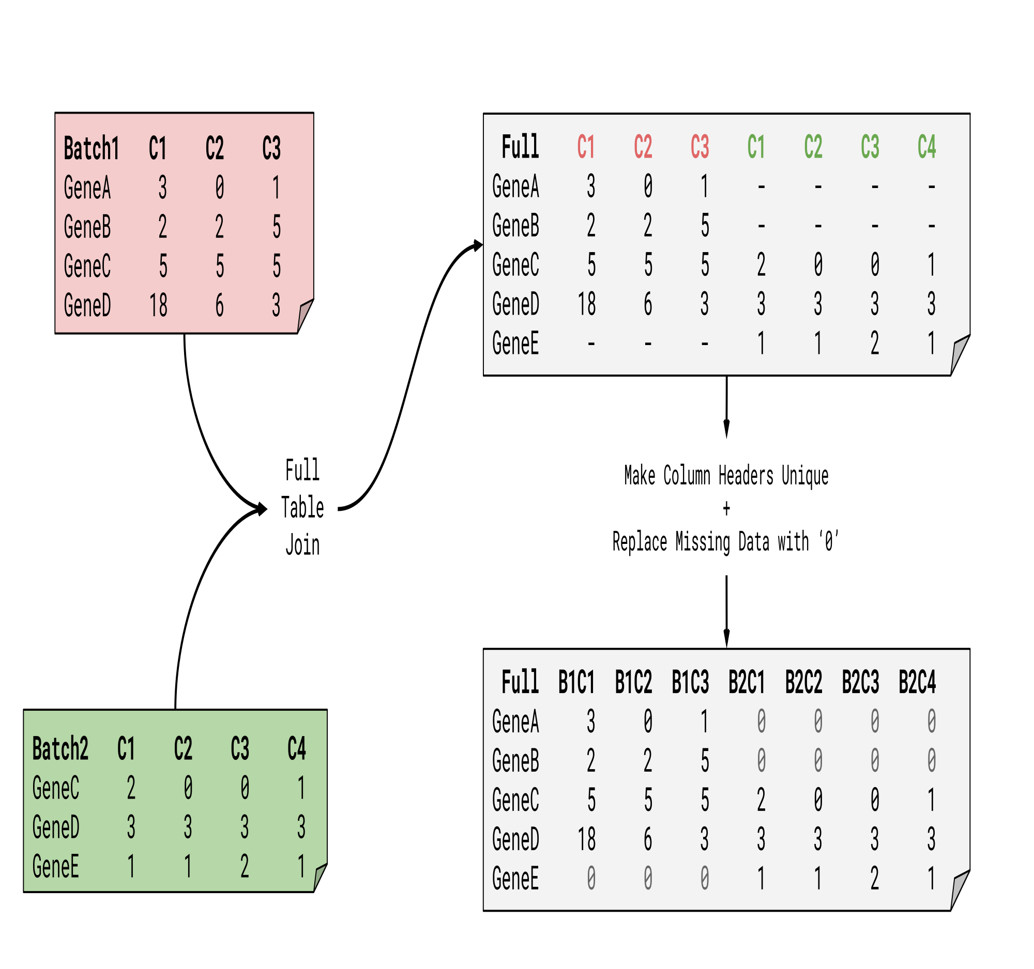
Data Preparation
.FASTQ
.gtf
.fastq
Barcodes and UMIs
Sequences
Annotation file
Demultiplexing
Alignment，and
Quantification
Counts Matrix
（tabular, Anndata, SingleCellExperiment, etc.）
Figure: Workflow of pre-processing. Wang Z, Hu J, Johnson WE, Campbell JD. (2019)
RNA-STAR
Filter BAM datasets on a variety of attributes
FeatureCounts
UMI-tools count
Cross-contamination Barcode Filter
Tools
Note:
Require fastq files from different sequencing methods
GTF2GeneList
Alevin
RNA STARsolo
https://training.galaxyproject.org/training-material/topics/transcriptomics/images/scrna_fulltable.svg

Slide 19
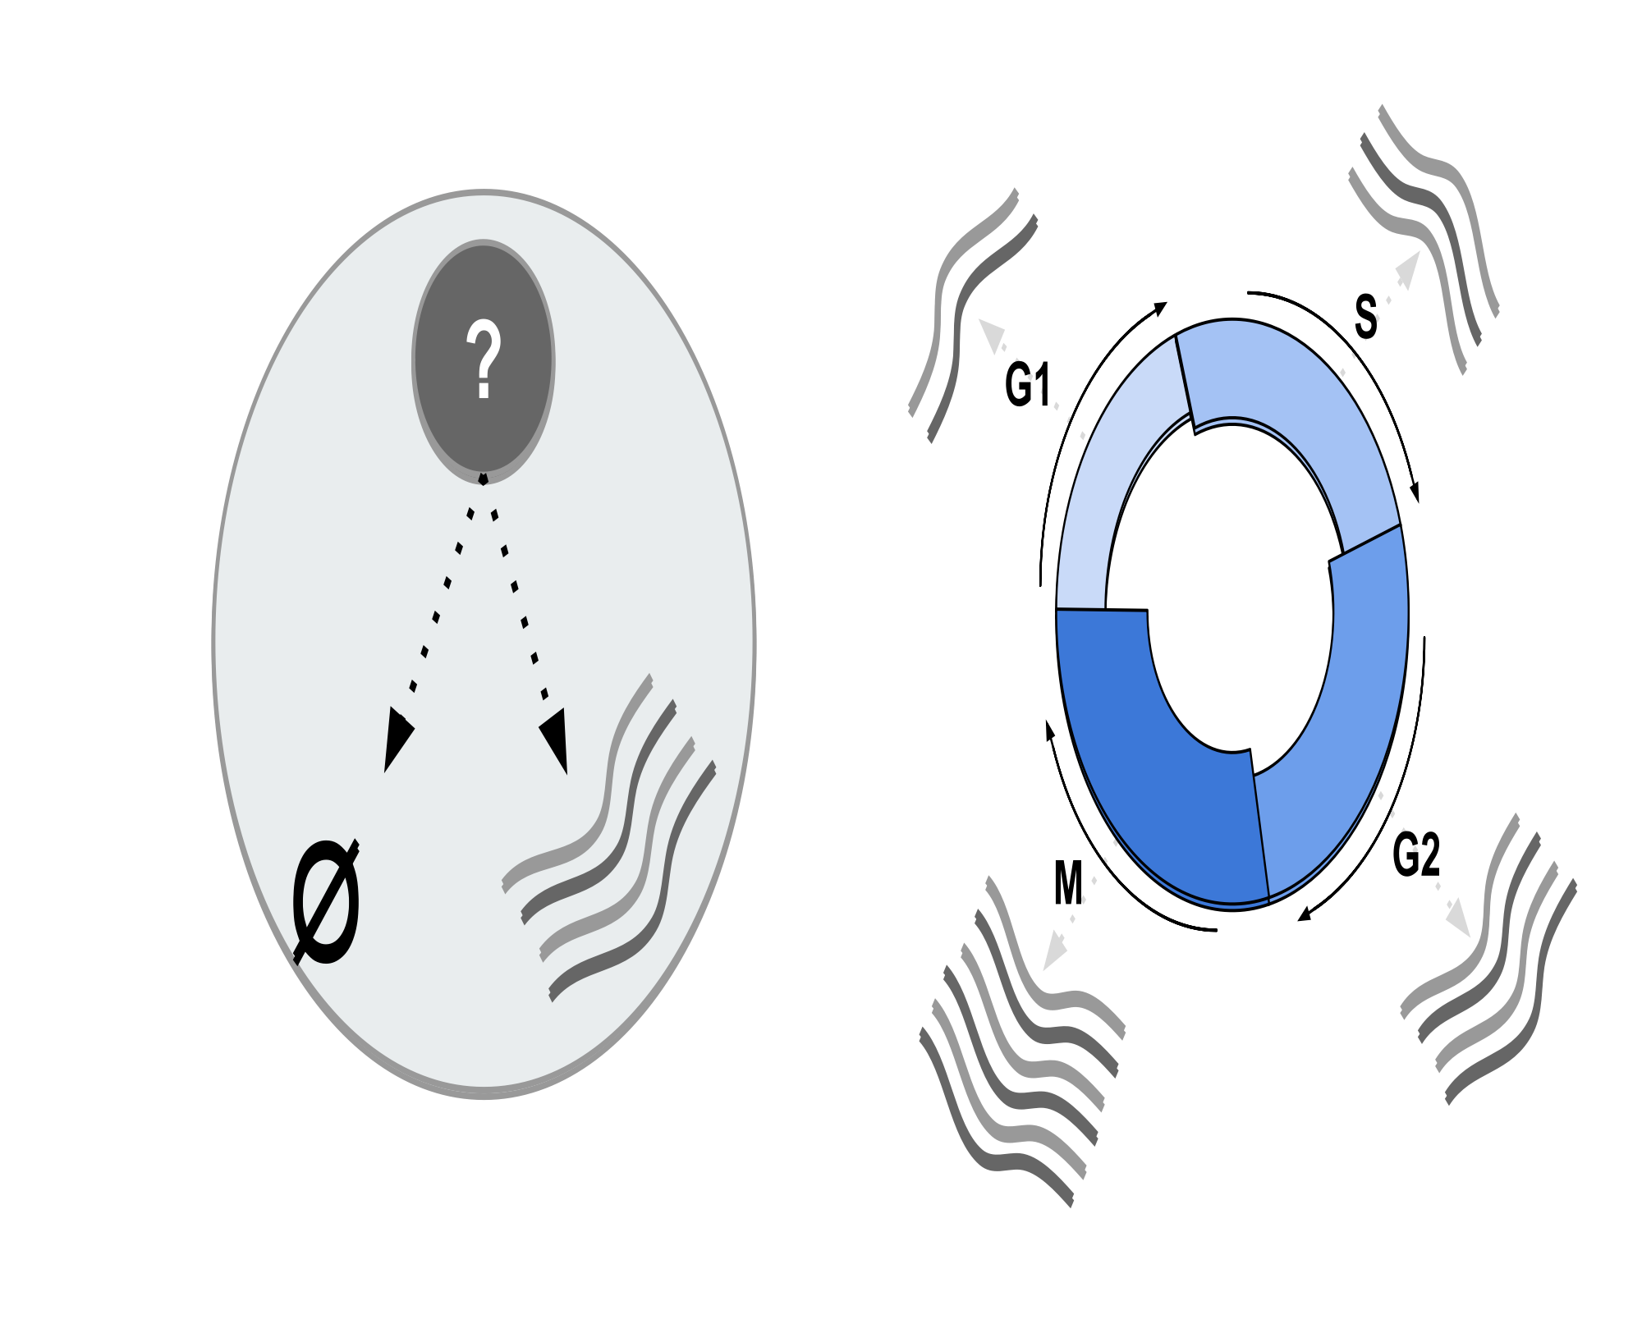
Quality Control
Biological Variation
(transcriptional burst, cell cycle...)
More precise experiment
UMIs
Technical Variation
(library size, amplification bias, dropout events...)
Quality control
https://training.galaxyproject.org/training-material/topics/transcriptomics/images/scrna-raceid/cellcycle.svg

Slide 20
Quality Control
Low library size:
Cells are very degraded or absent from the library preparation
Low number of expressed genes:
Poor-quality cells, followed by high PCR amplification of the remaining RNA
High mitochondrial gene content:
Damaged cells where the endogenous RNA escapes or degrades.
Remove:
Genes found in few cells
Cells with low counts (expression)
Cells with low features (genes)
Cells with high mitochondrial genes
Filter with scanpy
Manipulate Anndata
Scater: Calculate QC metrics
Scater: filter SCE
Tools
DropletUtils emptyDrops
Initial processing using RaceID

Slide 21
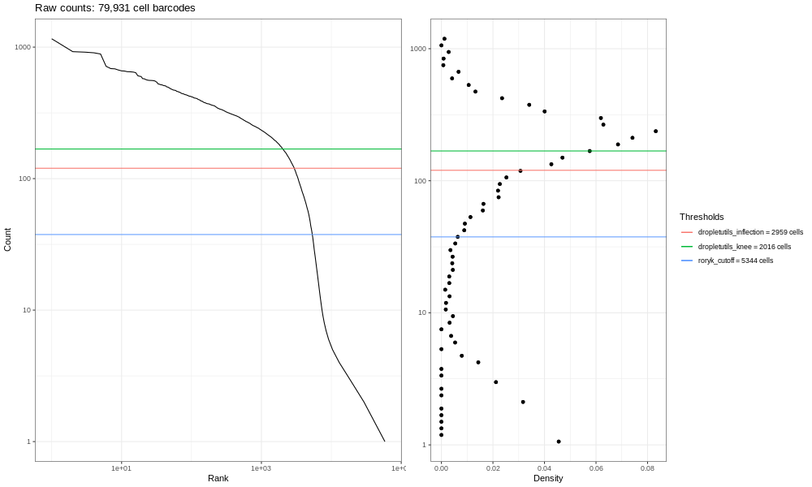
Quality Control
Cut-off
https://training.galaxyproject.org/training-material/topics/transcriptomics/images/wab-lung-atlas-barcodes-raw.png
Figure: Raw Counts Example

Slide 22
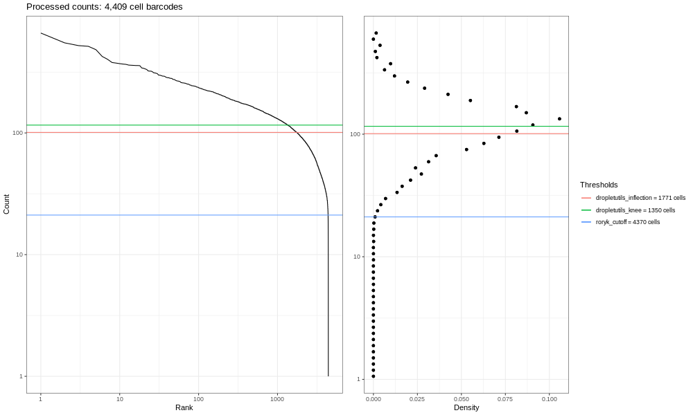
Quality Control
https://training.galaxyproject.org/training-material/topics/transcriptomics/images/wab-alevin-barcodes-lung.pngg
Figure: Filtered Counts Example (Threshod: UMIs < 10)

Slide 23
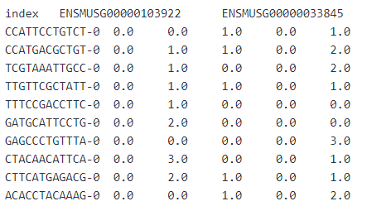
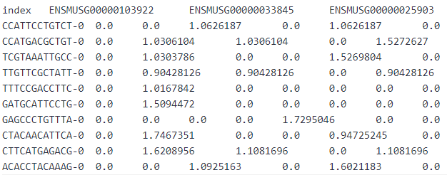
Normalisation and Scaling
Normalisation:
Normalisation helps reduce the differences between gene and UMI counts.
example:
similar total sum of counts across all genes for each cell ( e.g. 10000 counts)
Before
After
Scanpy NormaliseData
Scanpy ScaleData
Normalize with scanpy
Inspect and Manipulate with scanpy
Tools

Slide 24
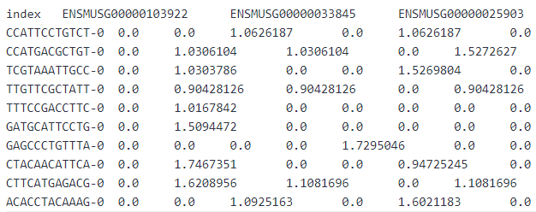
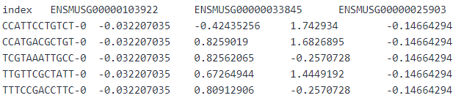
Normalisation and Scaling
Scaling:
Scaling helps to give equal weight in downstream analysis and ensure that highly-expressed genes do not dominate.
example:
the variance across cells is 1 and the mean expression is 0
Before
After
Scanpy NormaliseData
Scanpy ScaleData
Normalize with scanpy
Inspect and Manipulate with scanpy
Tools

Slide 25
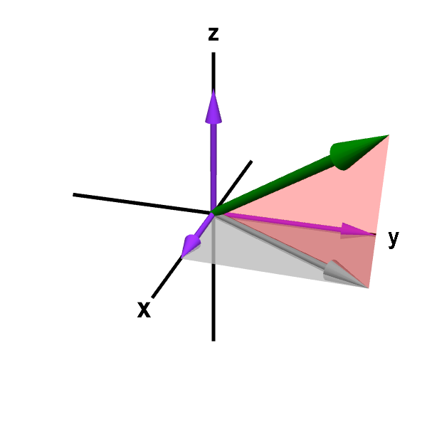
Dimensionality Reduction
Each cell’s expression profile defines its location in the high-dimensional expression space.
Dimensionality reduction aims to reduce the number of separate dimensions in the data and then:
reduces the computational work in downstream analyses to only a few dimensions
reduces noise by averaging across multiple genes to obtain a more precise representation of the patterns in the data
enables effective plotting of the data
https://mathinsight.org/media/applet/image/large/vector_3d_coordinates.png

Slide 26
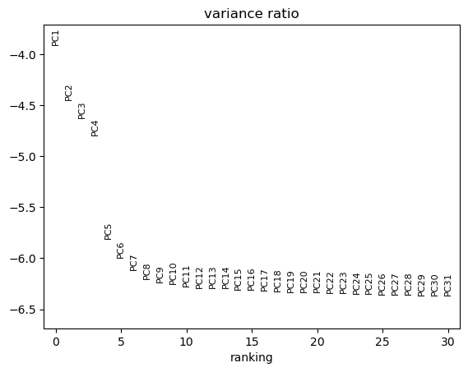

Dimensionality Reduction
Principal Component Analysis
Tools
Cluster, infer trajectories and embed with scanpy
Scanpy RunPCA
In PCA, the first axis (or Principal Component (PC)) is chosen such that it captures the greatest variance across cells.
The next PC should be orthogonal to the first and capture the greatest remaining amount of variation, and so on.
http://www.nlpca.org/fig_pca_principal_component_analysis.png

Slide 27
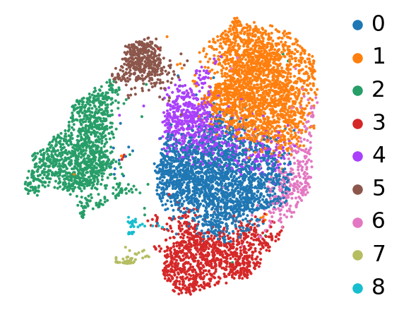
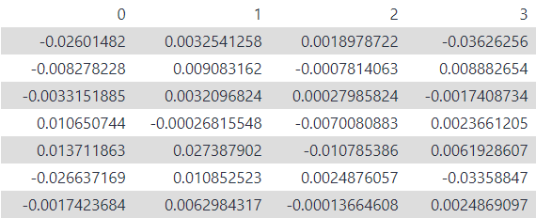
Clustering
Clustering information
Counts Matrix
（After QC, normalisation and scaling）
Dimensionality reduction for visualisation
PCs information
Clustering summarizes the data and allows us to describe the population heterogeneity in terms of discrete and easily understandable labels.
The subpopulations can be afterwards treated as proxies for biological objects like cell types or states.

Slide 28
Clustering
K-nearest neighbor (Graph-based clustering)
1. Computation of a neighborhood graph:
A graph is first built with each node being a cell connected to its nearest neighbours having similar expression patterns.
2. Visualization of the neighborhood graph:
An extra step of non-linear dimensional reduction techniques is applied to place similar cells together in low-dimensional space. ( t-SNE, UMAP, etc.)
3. Clustering of the neighborhood graph:
The graph is then partitioned into highly interconnected “communities”. (Louvain graph-clustering method, etc.)
Inspect and Manipulate with scanpyScanpy ScaleData
Cluster, infer trajectories and embed with scanpy
Scanpy ComputeGraph
Scanpy RunUMAP
Scanpy RunTSNE
Scanpy FindCluster
Clustering using RaceID
Cluster Inspection using RaceID
Tools

Slide 29
Annotation (Optional)
Identify the genes that drive separation between clusters
Prior biological knowledge
Marker genes
Canonical markers
Cell types
What do the clusters represent?
Which cell type? cell state?
Inspect and Manipulate with scanpy
Manipulate Anndata
Scanpy FindMarkers
Inspect AnnData
Manipulate AnnData
Tools

Slide 30
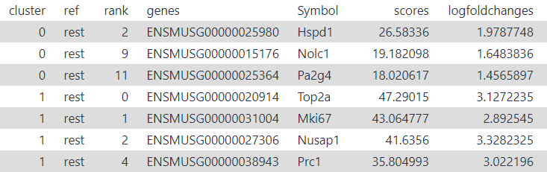
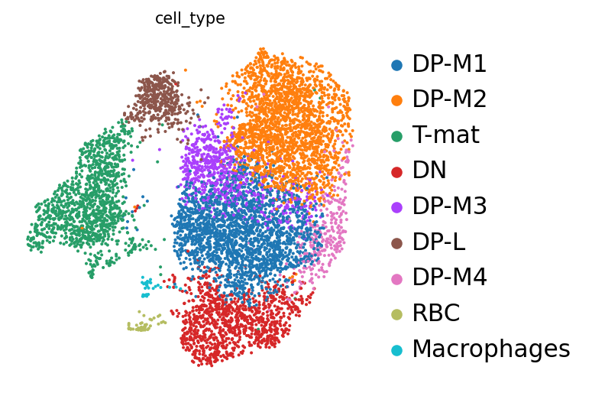
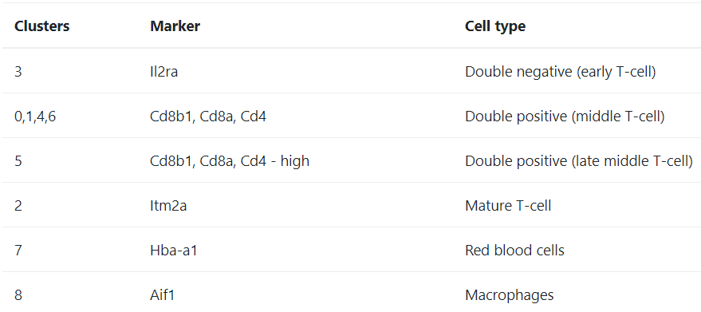
Annotation (Optional)
Marker genes
Cell types annotation
Canonical markers

Slide 31
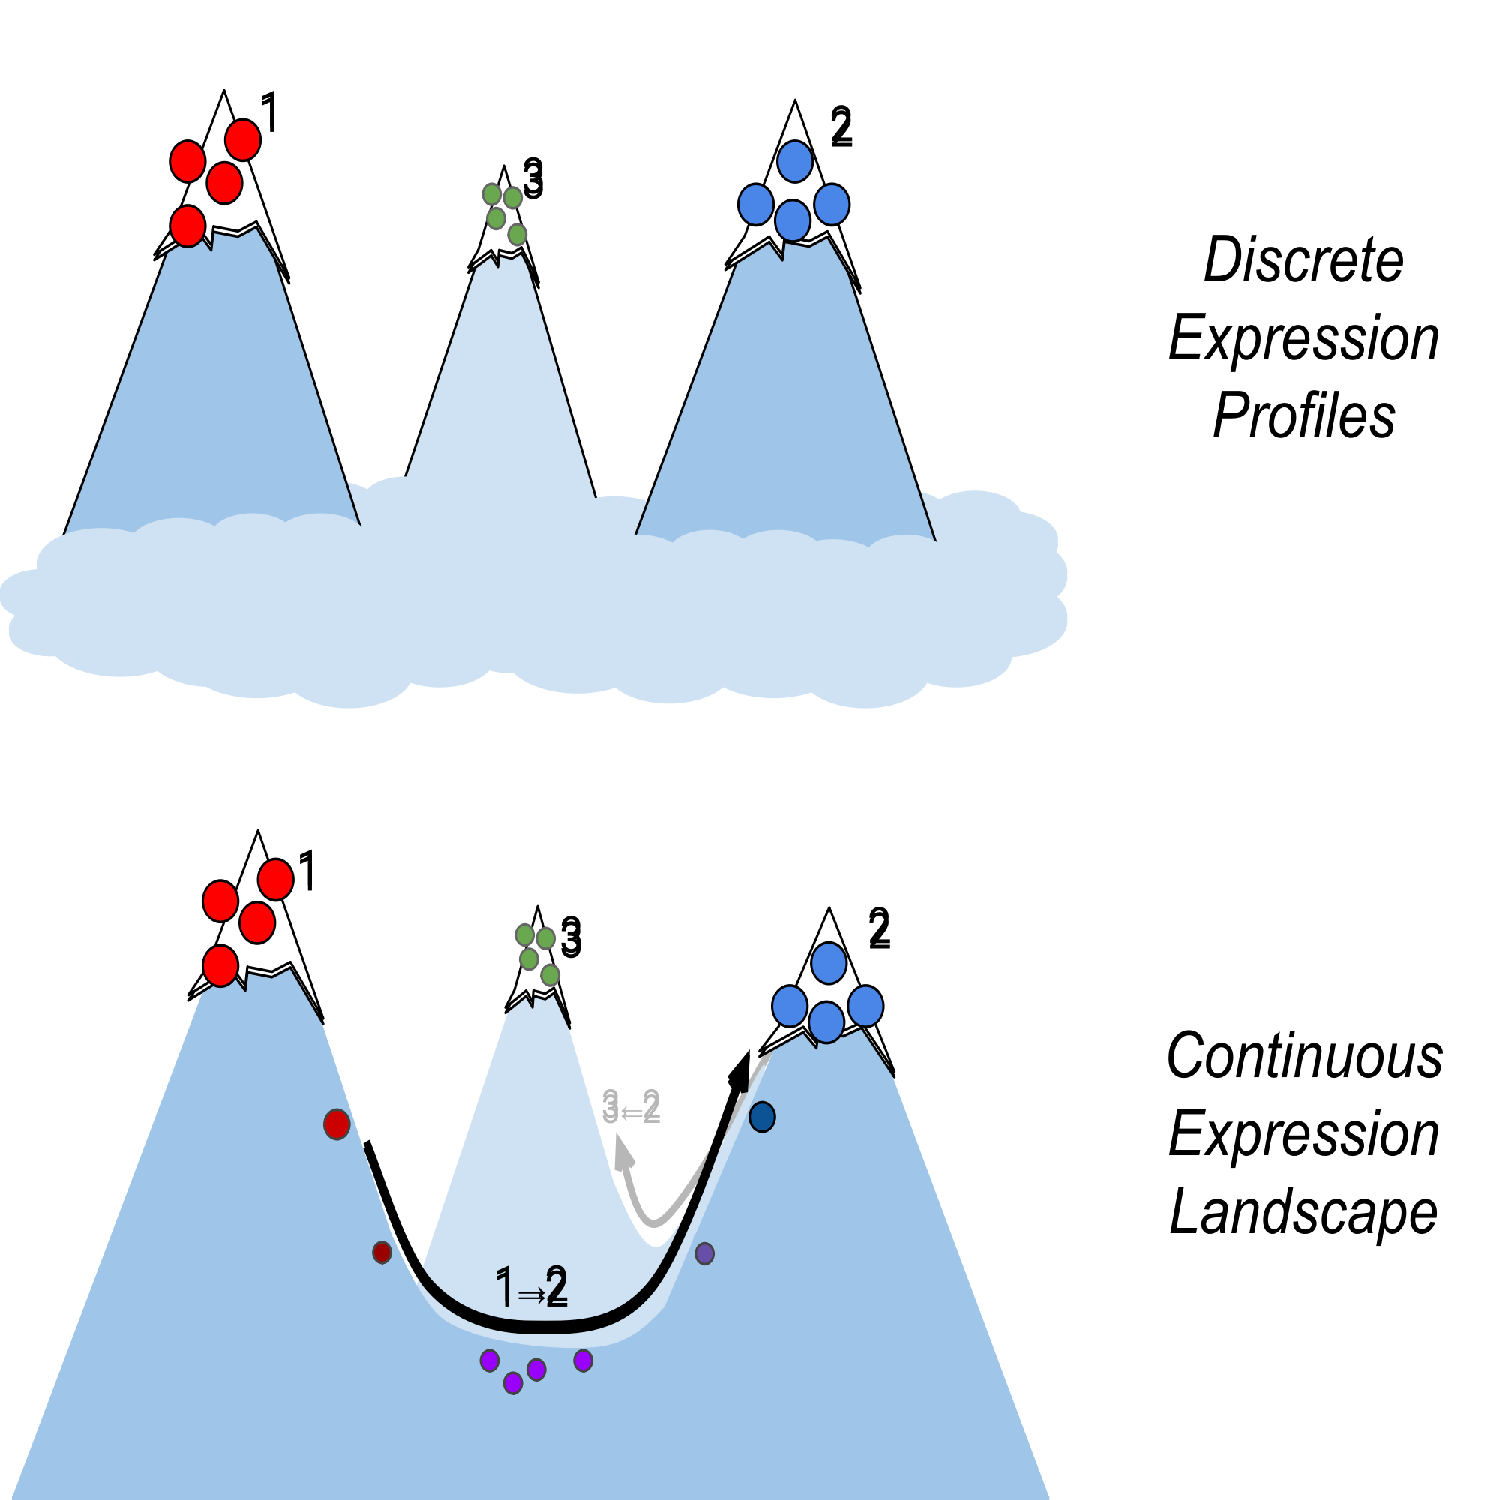
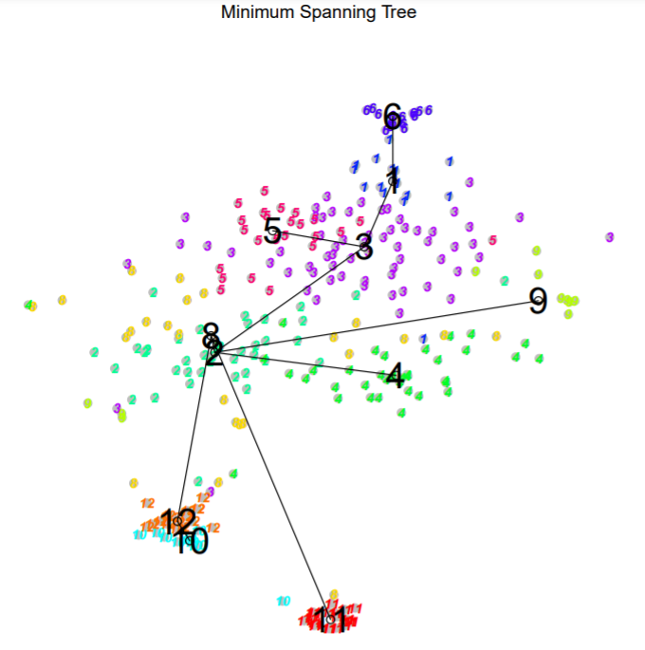
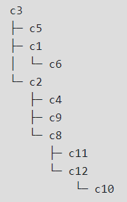
Others (Optional)
Trajectory and Lineage Analysis
Cluster Tree Diagram
Tools：stemID
Clusters displayed are not discrete entities, but are related through some continuous topology as inferred by intermediate cell types.

Slide 32
.FASTQ
.gtf
.FASTQ
.fastq
.fastq
Sequencing
Data Preparation
Quality Control
Normalisation and Scaling
Dimensionality Reduction
Clustering
Annotation,
Lineage Analysis, etc.

Slide 33
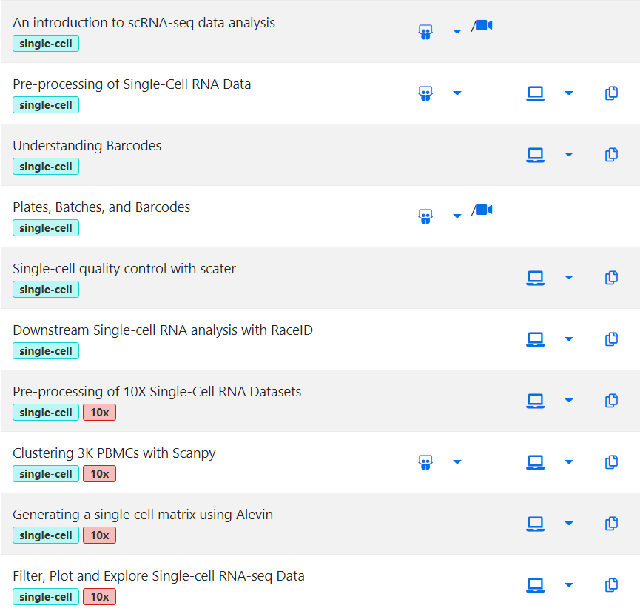
Pre-processing Tools
RNA-solo
scater
Alevin
Clustering Tools
RaceID
Scanpy

Slide 34
Thank you！

